Slide 1
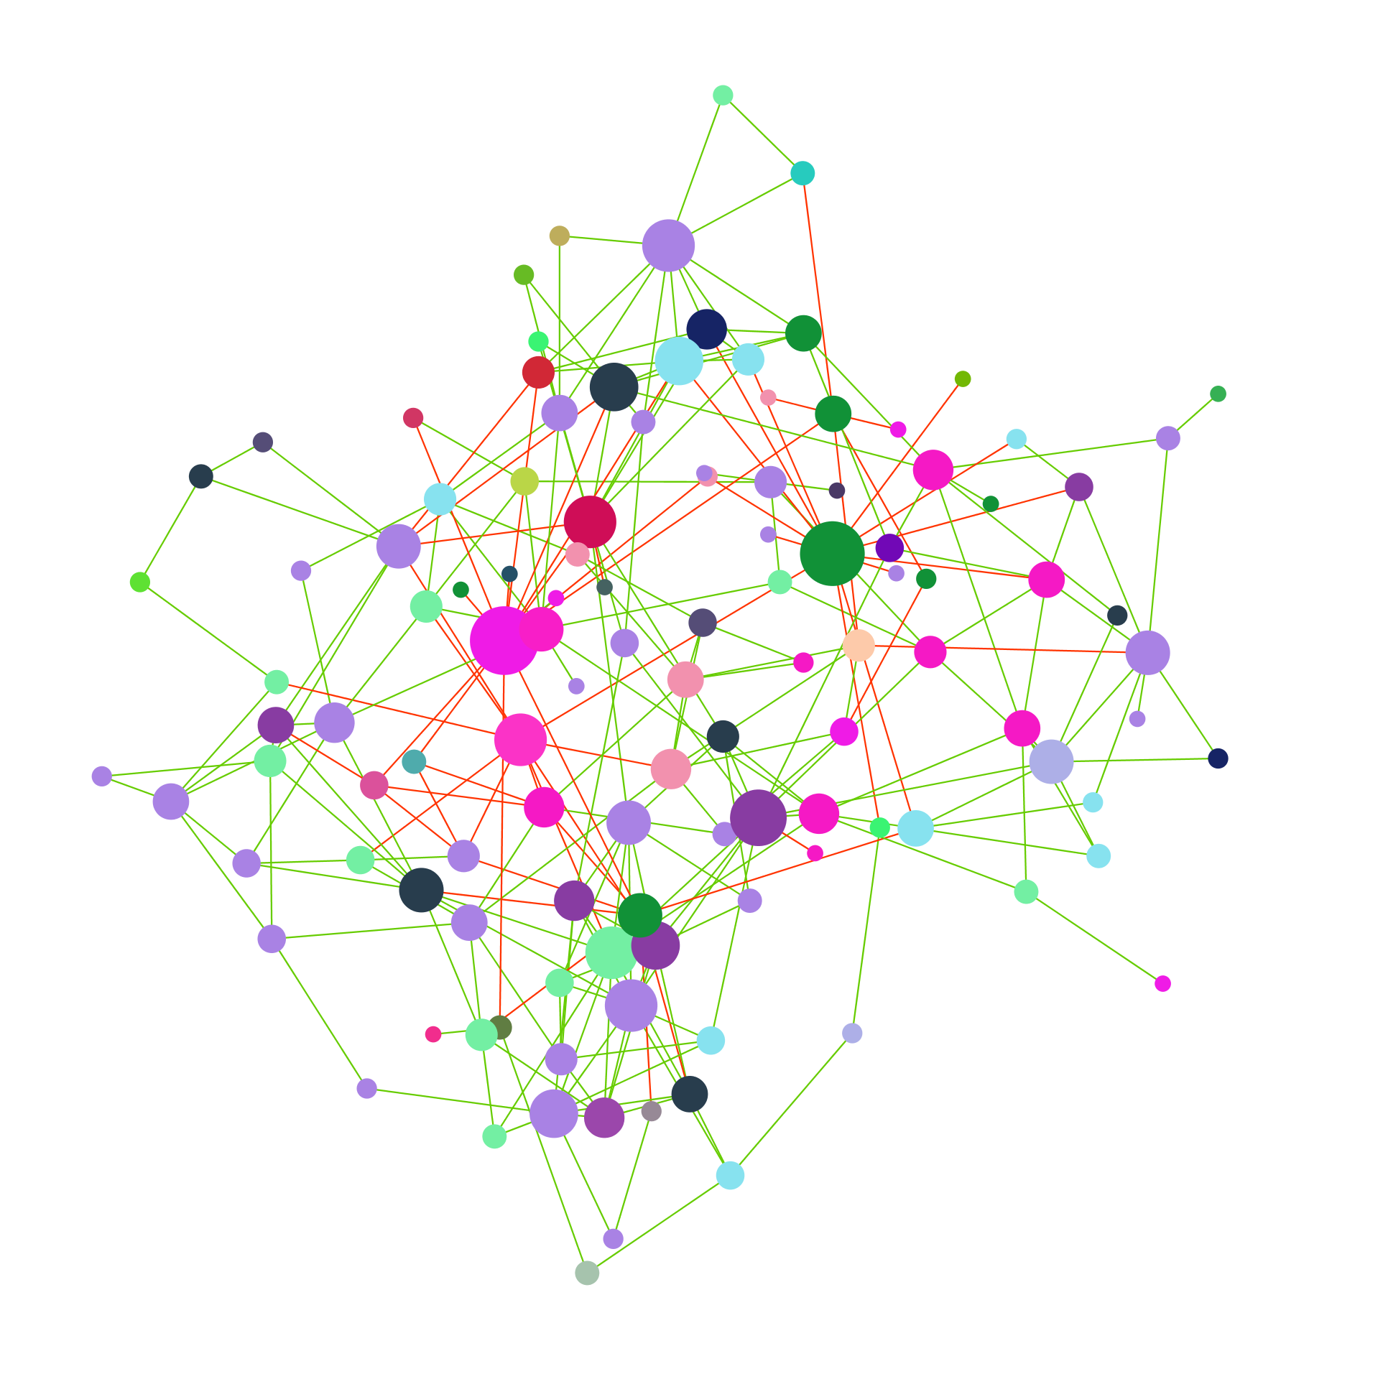

Microbial network inference through time and space: tools & network analysis
Lisa Röttjers
Lab of Microbial Systems Biology
REGA institute, KU Leuven
ramellose/networktutorials

Slide 2
Today
9:00-9:45 Microbial network inference
9:45-10:30 SPIEC-EASI tutorial
10:45-11:30 Microbial network analysis
11:30-12:00 Analysis of SPIEC-EASI network
13:00-14:00 LIMITS or CoNet tutorial

Slide 3
Overview
Introduction to microbial networks
Pitfalls before network construction
Tools for cross-sectional analysis
Tools for longitudinal analysis
Conclusion

Slide 4
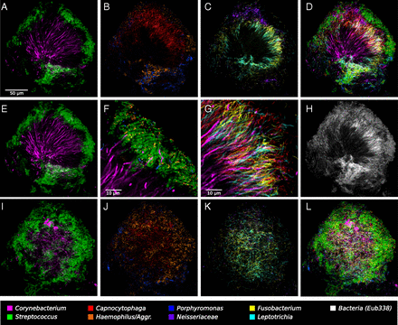
Microbial organisms interact
Welch et al. (2016). Biogeography of a human oral microbiome at the micron scale. Proceedings of the National Academy of Sciences, 113(6), E791-E800.

Slide 5
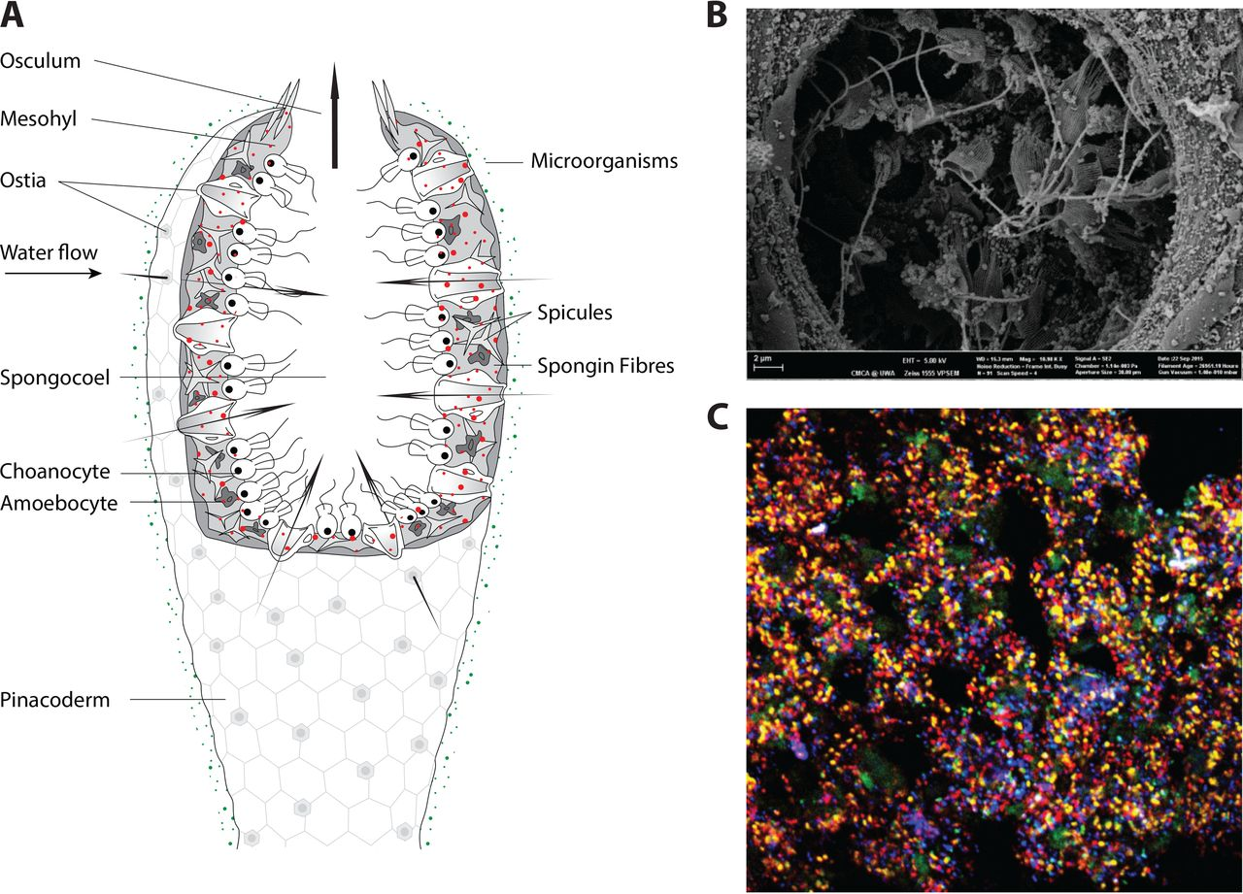
Microbial organisms interact
Webster & Thomas. (2016). The sponge hologenome. MBio, 7(2), e00135-16.

Slide 6
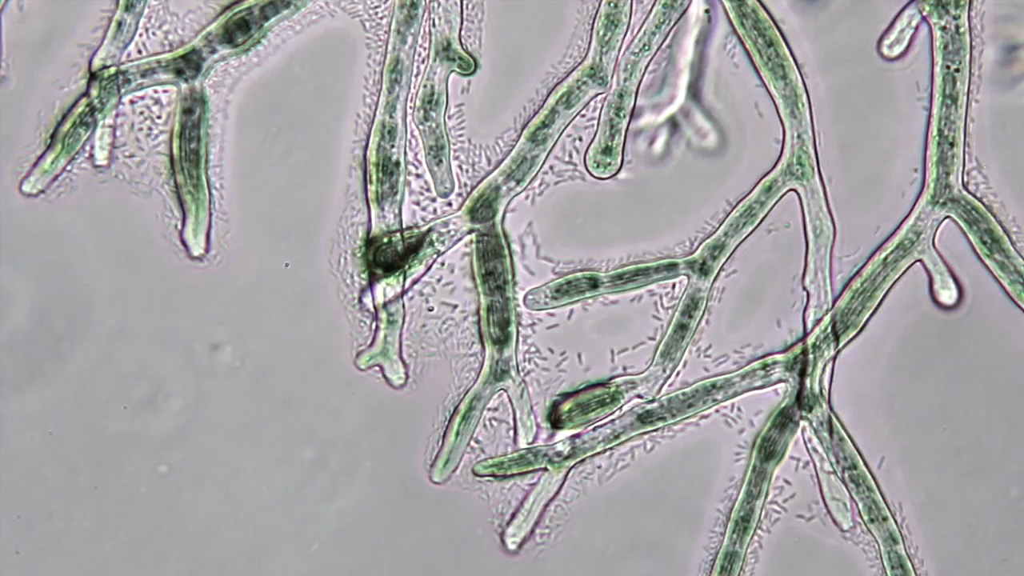
Microbial organisms interact
Zhang et al. (2018). Fungal networks shape dynamics of bacterial dispersal and community assembly in cheese rind microbiomes. Nature communications, 9(1), 336.

Slide 7
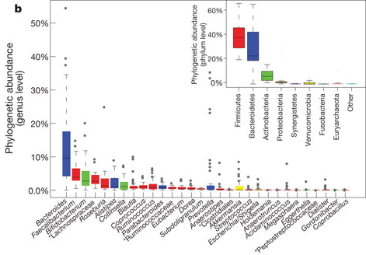
From diversity to functional understanding
Who is there?
Falony et al. (2016). Population-level analysis of gut microbiome variation. Science, 352(6285), 560-564.
Faust et al. (2012). Microbial co-occurrence relationships in the human microbiome. PLoS computational biology, 8(7), e1002606.

Slide 8
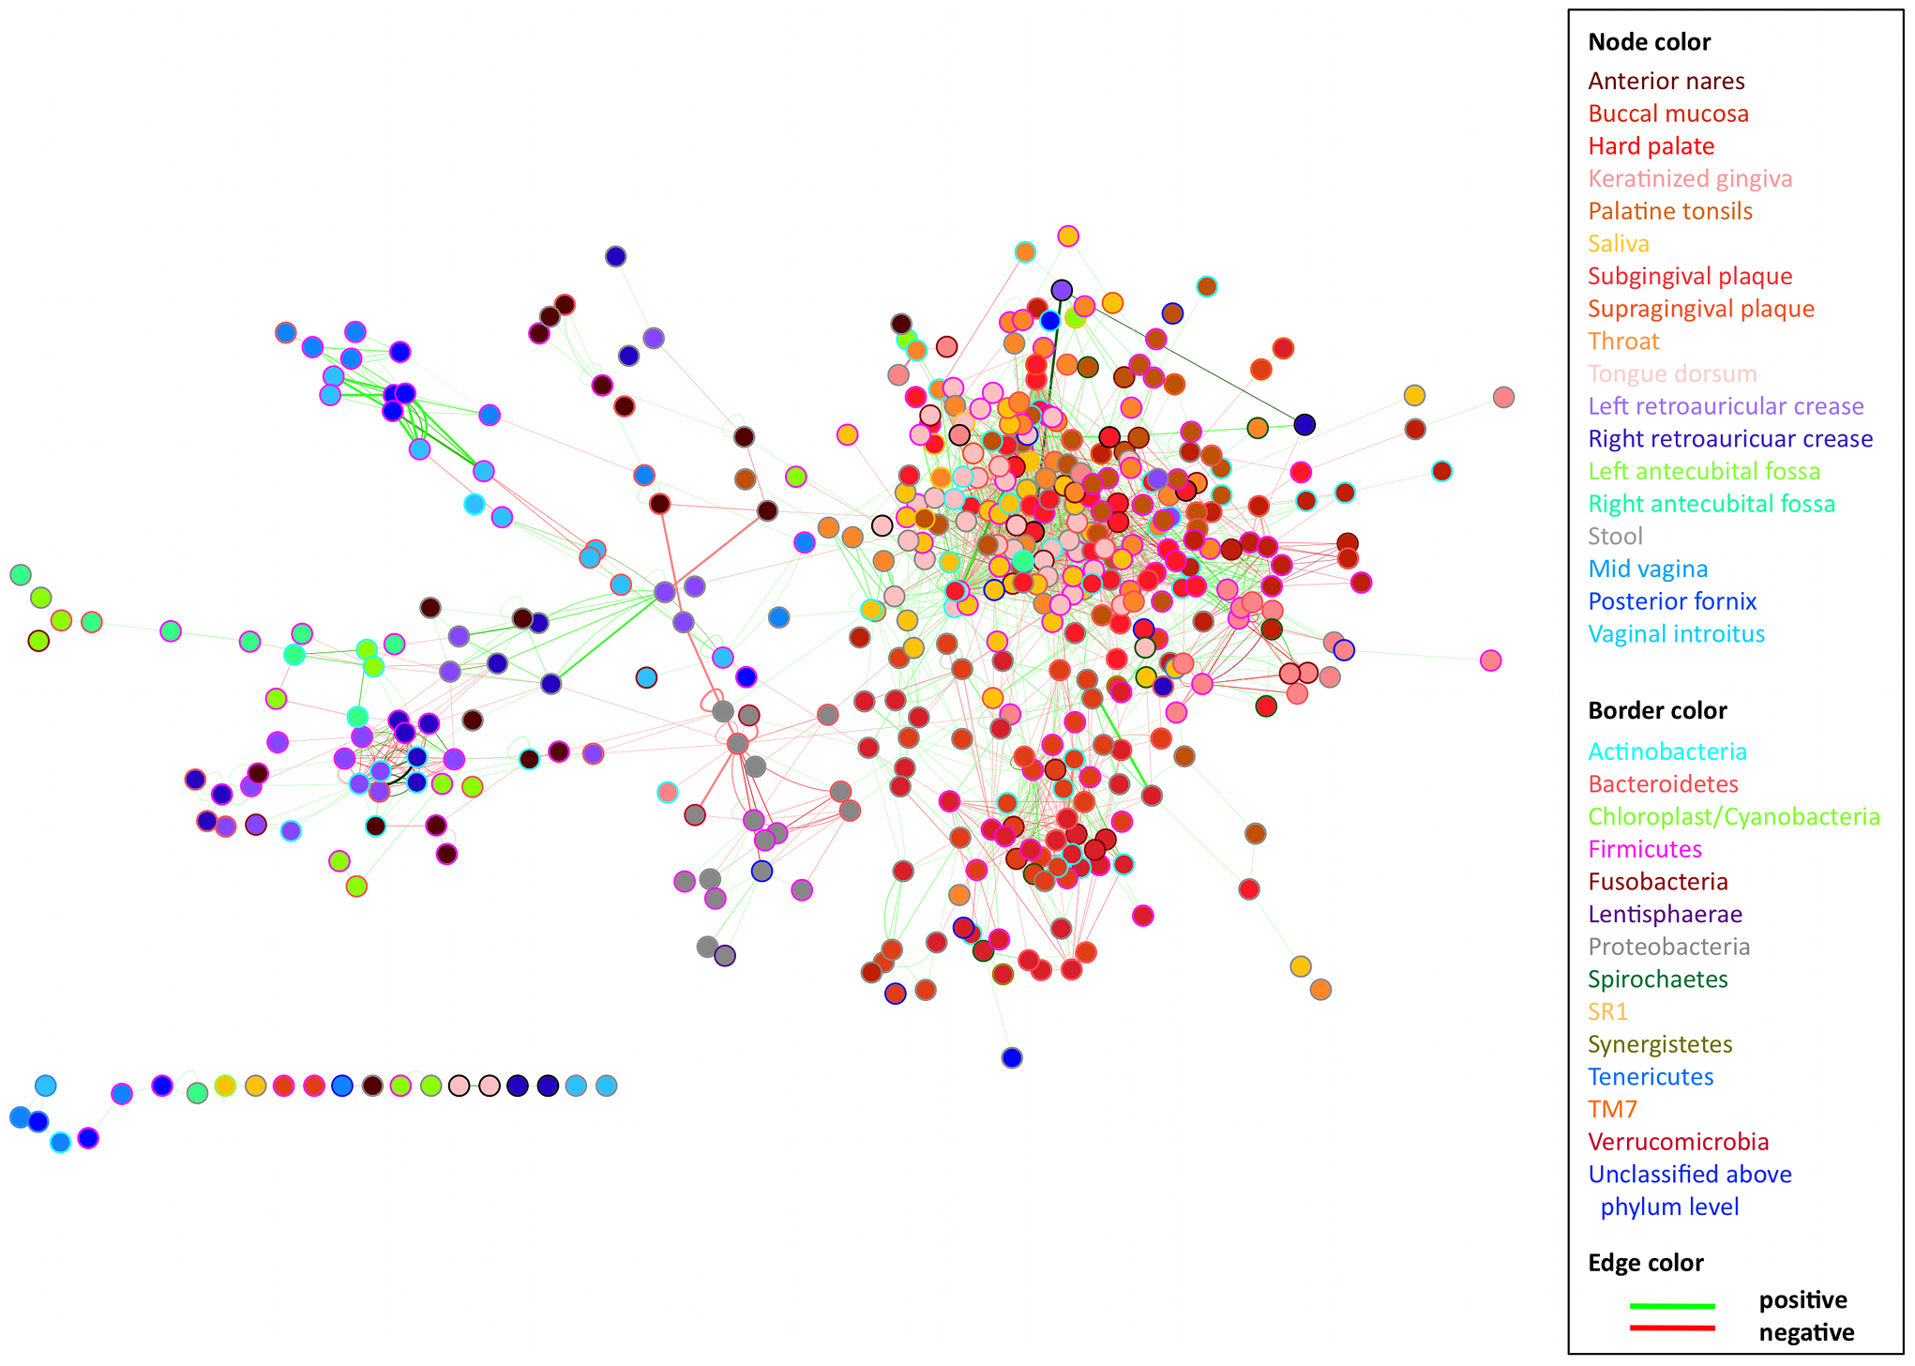
From diversity to functional understanding
Who is there? What do they associate with?
Falony et al. (2016). Population-level analysis of gut microbiome variation. Science, 352(6285), 560-564.
Faust et al. (2012). Microbial co-occurrence relationships in the human microbiome. PLoS computational biology, 8(7), e1002606.

Slide 9
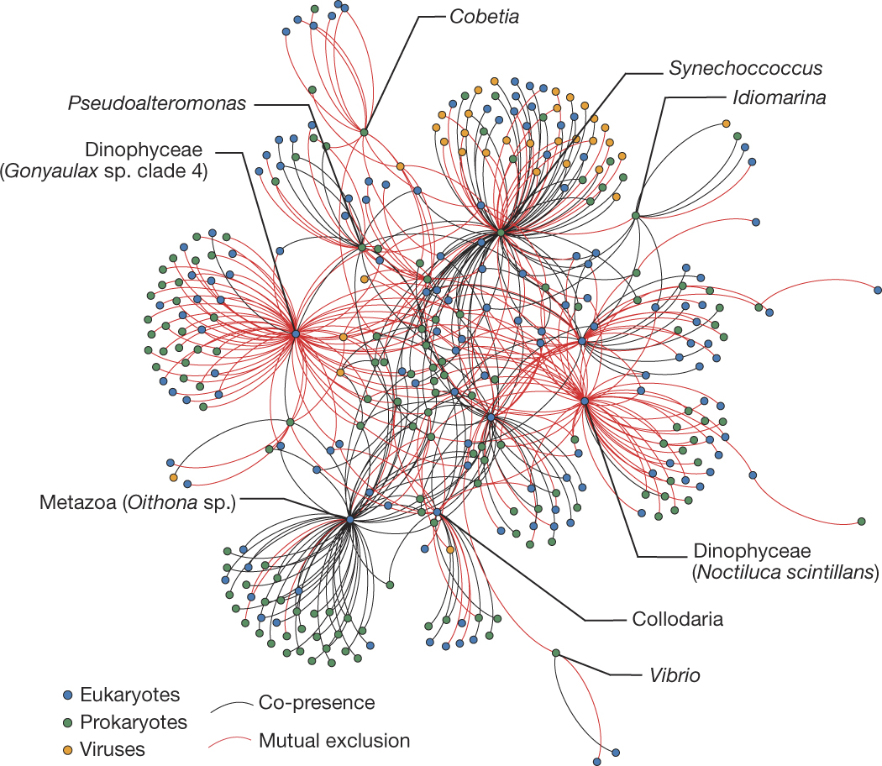
What are microbial networks?
Guidi et al. (2016). Plankton networks driving carbon export in the oligotrophic ocean. Nature, 532(7600), 465.

Slide 10
What are microbial networks?
Nodes represent taxa
Node
Guidi et al. (2016). Plankton networks driving carbon export in the oligotrophic ocean. Nature, 532(7600), 465.

Slide 11
What are microbial networks?
Nodes represent taxa
Edges represent associations
Edge
Node
Guidi et al. (2016). Plankton networks driving carbon export in the oligotrophic ocean. Nature, 532(7600), 465.

Slide 12
How do we get microbial associations?

Slide 13
How do we get microbial associations?
Co-occurrence

Slide 14
How do we get microbial associations?
Co-occurrence
Mutual exclusion

Slide 15
How do we get microbial associations?
Co-occurrence
Mutual exclusion
Inverse covariance

Slide 16
How do we get microbial associations?
Co-occurrence
Mutual exclusion
Inverse covariance
Suggested to reflect competition patterns

Slide 17
Networks from longitudinal or cross-sectional data
Sample 1
Sample 2
Sample 3

Slide 18
Networks from longitudinal or cross-sectional data
Sample 1
Sample 2
Sample 3
Low abundance of blue taxon
is associated with low abundance of orange taxon

Slide 19
Networks from longitudinal or cross-sectional data
Sample 1
Sample 2
Sample 3
Low abundance of blue taxon
precedes low abundance of orange taxon

Slide 20
Problem: sampling depth
Rarefied sample

Slide 21
Problem: sampling depth
Not sequenced equally deeply
Rarefied sample

Slide 22
Problem: sampling depth
Not sequenced equally deeply
Rarefied sample
All taxa sampled

Slide 23
Problem: sampling depth
Not sequenced equally deeply
Rarefied sample
Shallowly sequenced

Slide 24
Problem: sampling depth
Not sequenced equally deeply
Rarefied sample
Deeply sequenced

Slide 25
Problem: sampling depth
Samples differ in biomass
Not sequenced equally deeply
Rarefied sample

Slide 26
Problem: sampling depth
Samples differ in biomass
Not sequenced equally deeply
Rarefied sample
All taxa sampled

Slide 27
Problem: sampling depth
Samples differ in biomass
Not sequenced equally deeply
Rarefied sample
Shallowly sequenced

Slide 28
Problem: sampling depth
Samples differ in biomass
Not sequenced equally deeply
Rarefied sample
Deeply sequenced

Slide 29
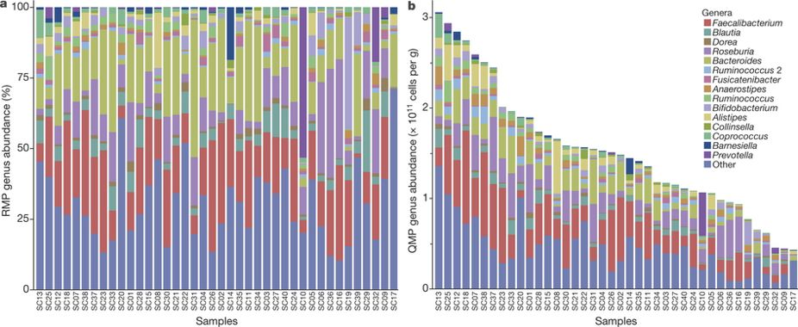
Microbial associations from 16S rRNA
Compositionality
Vandeputte et al. (2017). Quantitative microbiome profiling links gut community variation to microbial load. Nature, 551(7681).

Slide 30
Microbial associations from 16S rRNA
Compositionality
Vandeputte et al. (2017). Quantitative microbiome profiling links gut community variation to microbial load. Nature, 551(7681).

Slide 31
Microbial associations from 16S rRNA
Compositionality
Correct with quantitative data
Vandeputte et al. (2017). Quantitative microbiome profiling links gut community variation to microbial load. Nature, 551(7681).

Slide 32
Microbial associations from 16S rRNA
Compositionality
Correct with quantitative data
Use methods robust to compositionality (e.g. clr transformation)
Vandeputte et al. (2017). Quantitative microbiome profiling links gut community variation to microbial load. Nature, 551(7681).

Slide 33
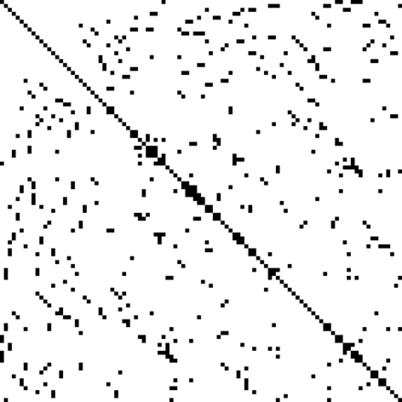
Microbial associations from 16S rRNA
Sparsity: most microbes are not counted
Some correlations also correlate zeros

Slide 34
Microbial associations from 16S rRNA
Sparsity: most microbes are not counted
Some correlations also correlate zeros
Pearson, Spearman
Sparsity affects clr transformation
Costa et al. (2012). Comparison of the fecal microbiota of healthy horses and horses with colitis by high throughput sequencing of the V3-V5 region of the 16S rRNA gene. PloS one, 7(7), e41484.

Slide 35
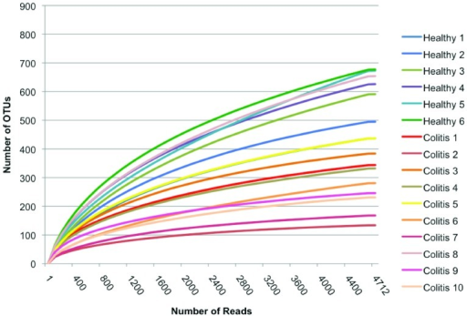
Microbial associations from 16S rRNA
Sparsity: most microbes are not counted
Some correlations also correlate zeros
Pearson, Spearman
Sparsity affects clr transformation
Rounded zeros or structural zeros?
Costa et al. (2012). Comparison of the fecal microbiota of healthy horses and horses with colitis by high throughput sequencing of the V3-V5 region of the 16S rRNA gene. PloS one, 7(7), e41484.

Slide 36
Microbial associations from 16S rRNA
Sparsity: most microbes are not counted
Some correlations also correlate zeros
Pearson, Spearman
Sparsity affects clr transformation
Rounded zeros or structural zeros?
Apply filter to reduce sparsity
Costa et al. (2012). Comparison of the fecal microbiota of healthy horses and horses with colitis by high throughput sequencing of the V3-V5 region of the 16S rRNA gene. PloS one, 7(7), e41484.

Slide 37
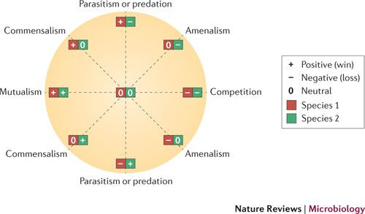
Microbial associations
Associations =/= interactions
Faust & Raes. (2012). Microbial interactions: from networks to models. Nature Reviews Microbiology, 10(8), 538.

Slide 38
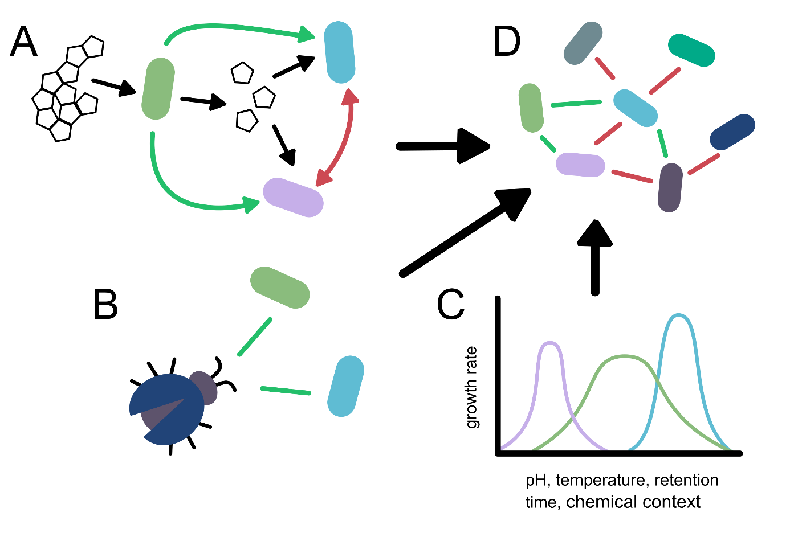
Microbial associations
Associations =/= interactions
Faust & Raes. (2012). Microbial interactions: from networks to models. Nature Reviews Microbiology, 10(8), 538.

Slide 39
Microbial associations
Associations =/= interactions
Faust & Raes. (2012). Microbial interactions: from networks to models. Nature Reviews Microbiology, 10(8), 538.

Slide 40
Microbial associations
Associations =/= interactions
Faust & Raes. (2012). Microbial interactions: from networks to models. Nature Reviews Microbiology, 10(8), 538.

Slide 41
Microbial associations
Associations =/= interactions
Faust & Raes. (2012). Microbial interactions: from networks to models. Nature Reviews Microbiology, 10(8), 538.

Slide 42
Microbial associations
van Vliet, S., Kiviet, D. J., Schlegel, S., & Ackermann, M. (2019). Short-range interactions govern cellular dynamics in microbial multi-genotype systems. bioRxiv, 530584.

Slide 43
Microbial associations
van Vliet, S., Kiviet, D. J., Schlegel, S., & Ackermann, M. (2019). Short-range interactions govern cellular dynamics in microbial multi-genotype systems. bioRxiv, 530584.

Slide 44
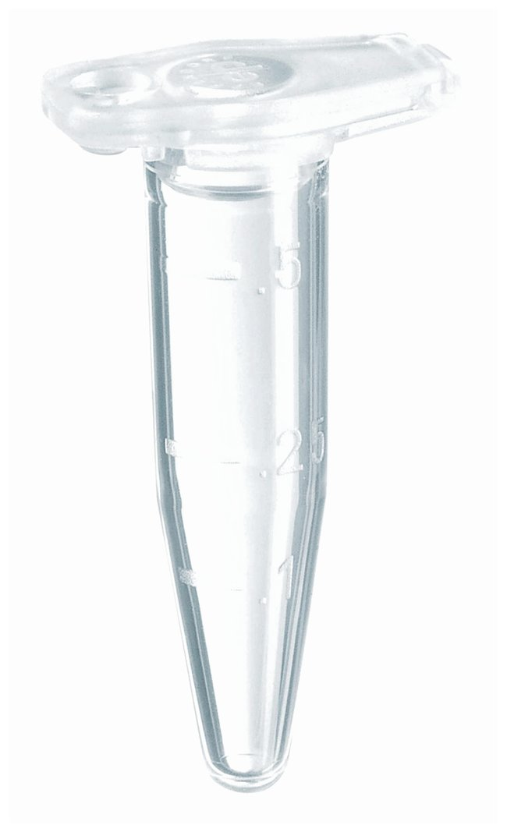
Microbial associations
van Vliet, S., Kiviet, D. J., Schlegel, S., & Ackermann, M. (2019). Short-range interactions govern cellular dynamics in microbial multi-genotype systems. bioRxiv, 530584.

Slide 45
Microbial associations
Associations =/= interactions
Can represent environment
Faust & Raes. (2012). Microbial interactions: from networks to models. Nature Reviews Microbiology, 10(8), 538.

Slide 46
Tools for cross-sectional network analysis
ccrepe
CoNet
FlashWeave
SparCC
Spearman
SPIEC-EASI
WGCNA
… And many more

Slide 47
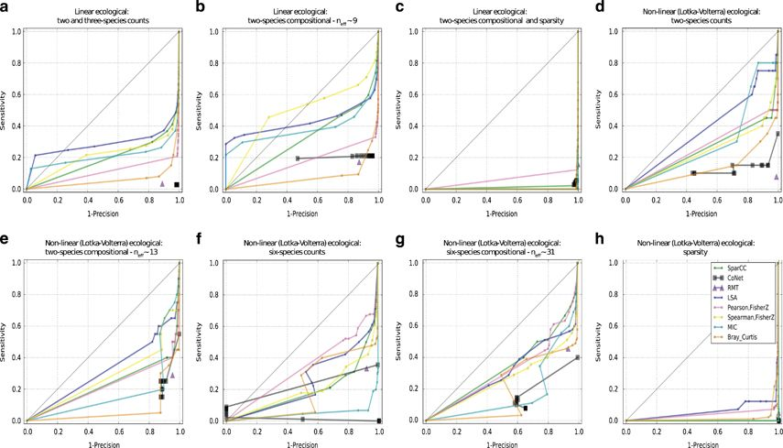
Tools for cross-sectional network analysis
ccrepe
CoNet
FlashWeave
SparCC
Spearman
SPIEC-EASI
WGCNA
… And many more
Weiss et al (2016). Correlation detection strategies in microbial data sets vary widely in sensitivity and precision. The ISME journal, 10(7), 1669.

Slide 48
Tools for cross-sectional network analysis
ccrepe
CoNet
FlashWeave
SparCC
Spearman
SPIEC-EASI
WGCNA
… And many more
Weiss et al (2016). Correlation detection strategies in microbial data sets vary widely in sensitivity and precision. The ISME journal, 10(7), 1669.

Slide 49
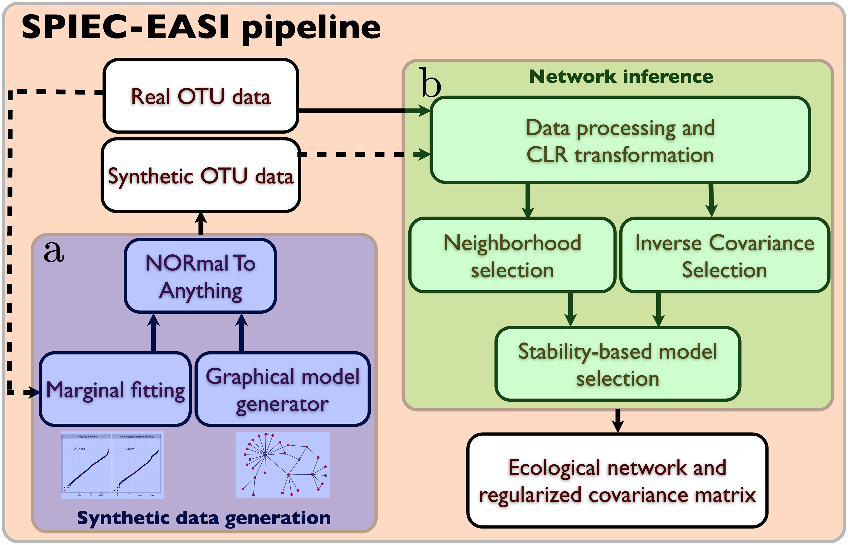
SPIEC-EASI
Sparse InversE Covariance estimation for Ecological Assocation Inference
Kurtz et al. (2015). Sparse and compositionally robust inference of microbial ecological networks. PLoS computational biology, 11(5), e1004226.

Slide 50
SPIEC-EASI
Sparse InversE Covariance estimation for Ecological Assocation Inference
Centered log-ratio transformation
Neighborhood selection
Solves regularized linear regression
Inverse Covariance selection
Solves penalized maximum likelihood
Kurtz et al. (2015). Sparse and compositionally robust inference of microbial ecological networks. PLoS computational biology, 11(5), e1004226.

Slide 51
SPIEC-EASI
Sparse InversE Covariance estimation for Ecological Assocation Inference
Centered log-ratio transformation
Neighborhood selection
Solves regularized linear regression
Inverse Covariance selection
Solves penalized maximum likelihood
Stability-based model selection (StARs)
Take subsamples to calculate edge stability
Kurtz et al. (2015). Sparse and compositionally robust inference of microbial ecological networks. PLoS computational biology, 11(5), e1004226.

Slide 52
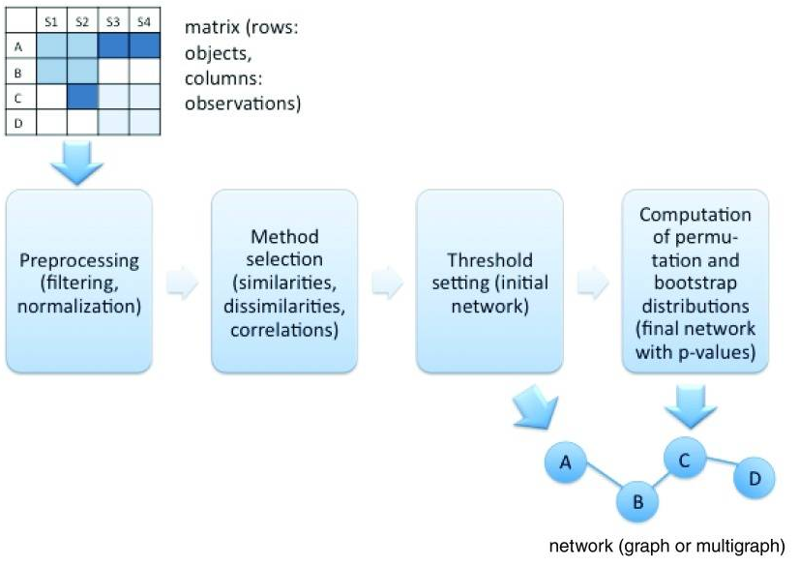
CoNet
Combines measures
Pearson
Spearman
MIC
Bray-Curtis
Faust & Raes. (2016). CoNet app: inference of biological association networks using Cytoscape. F1000Research, 5.

Slide 53
CoNet
Combines measures
Pearson
Spearman
MIC
Bray-Curtis
Permutation with renormalization (ReBoot)
Tackles compositionality
Faust & Raes. (2016). CoNet app: inference of biological association networks using Cytoscape. F1000Research, 5.

Slide 54
CoNet
Combines measures
Pearson
Spearman
MIC
Bray-Curtis
Permutation with renormalization (ReBoot)
Tackles compositionality
Bootstraps to compute p-values
Faust & Raes. (2016). CoNet app: inference of biological association networks using Cytoscape. F1000Research, 5.

Slide 55
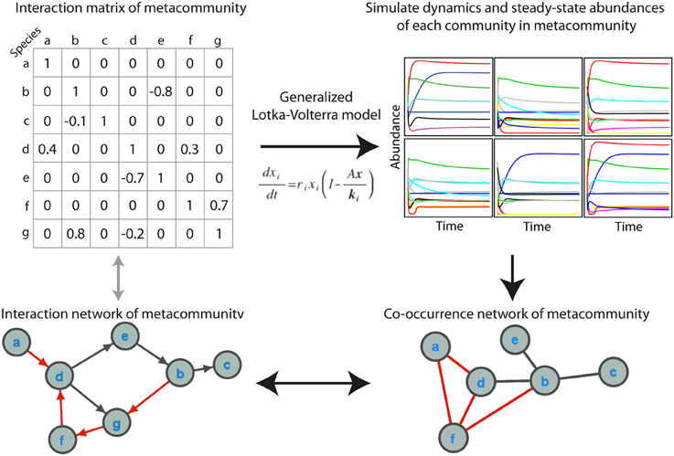
Approaches for longitudinal network analysis
Population models
Generalized Lotka-Volterra (LIMITS, MDSINE)
Ricker
Hubbell
Berry & Widder. (2014). Deciphering microbial interactions and detecting keystone species with co-occurrence networks. Frontiers in microbiology, 5, 219.

Slide 56
Approaches for longitudinal network analysis
Population models
Generalized Lotka-Volterra (LIMITS, MDSINE)
Ricker
Hubbell
Statistical approaches
ARIMA
VAR

Slide 57
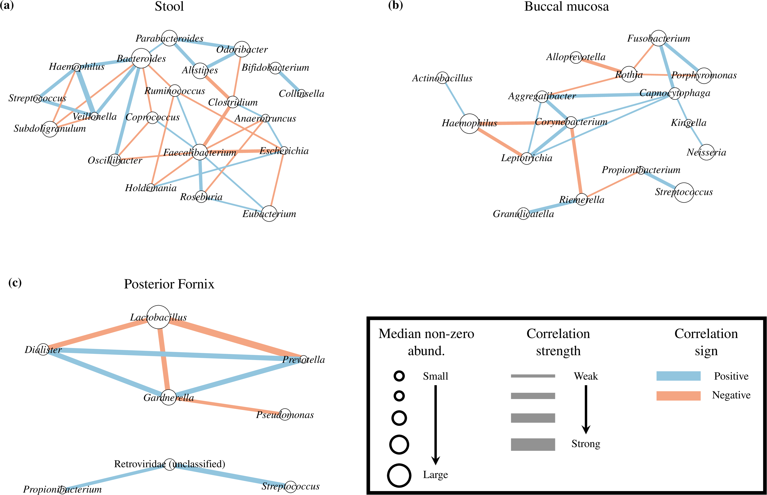
Approaches for longitudinal network analysis
Population models
Generalized Lotka-Volterra (LIMITS, MDSINE)
Ricker
Hubbell
Statistical approaches
ARIMA
VAR
Bayesian models (BAnOCC)
Schwager et al. (2017). A Bayesian method for detecting pairwise associations in compositional data. PLoS computational biology, 13(11), e1005852.

Slide 58
Approaches for longitudinal network analysis
Population models
Generalized Lotka-Volterra (LIMITS, MDSINE)
Ricker
Hubbell
Statistical approaches
ARIMA
VAR
Bayesian models (BAnOCC)
Local similarity (eLSA)

Slide 59
Approaches for longitudinal network analysis
Population models
Generalized Lotka-Volterra (LIMITS, MDSINE)
Ricker
Hubbell
Statistical approaches
ARIMA
VAR
Bayesian models (BAnOCC)
Local similarity (eLSA)
Most time series approaches require large sample numbers for model fitting

Slide 60
Approaches for longitudinal network analysis
Population models
Generalized Lotka-Volterra (LIMITS, MDSINE)
Ricker
Hubbell
Statistical approaches
ARIMA
VAR
Bayesian models (BAnOCC)
Local similarity (eLSA)
Most time series approaches require large sample numbers for model fitting
Presence of temporal structure is a requirement

Slide 61
Approaches for longitudinal network analysis
Population models
Generalized Lotka-Volterra (LIMITS, MDSINE)
Ricker
Hubbell
Statistical approaches
ARIMA
VAR
Bayesian models (BAnOCC)
Local similarity (eLSA)
Most time series approaches require large sample numbers for model fitting
Presence of temporal structure is a requirement
Not all tools support replicates

Slide 62
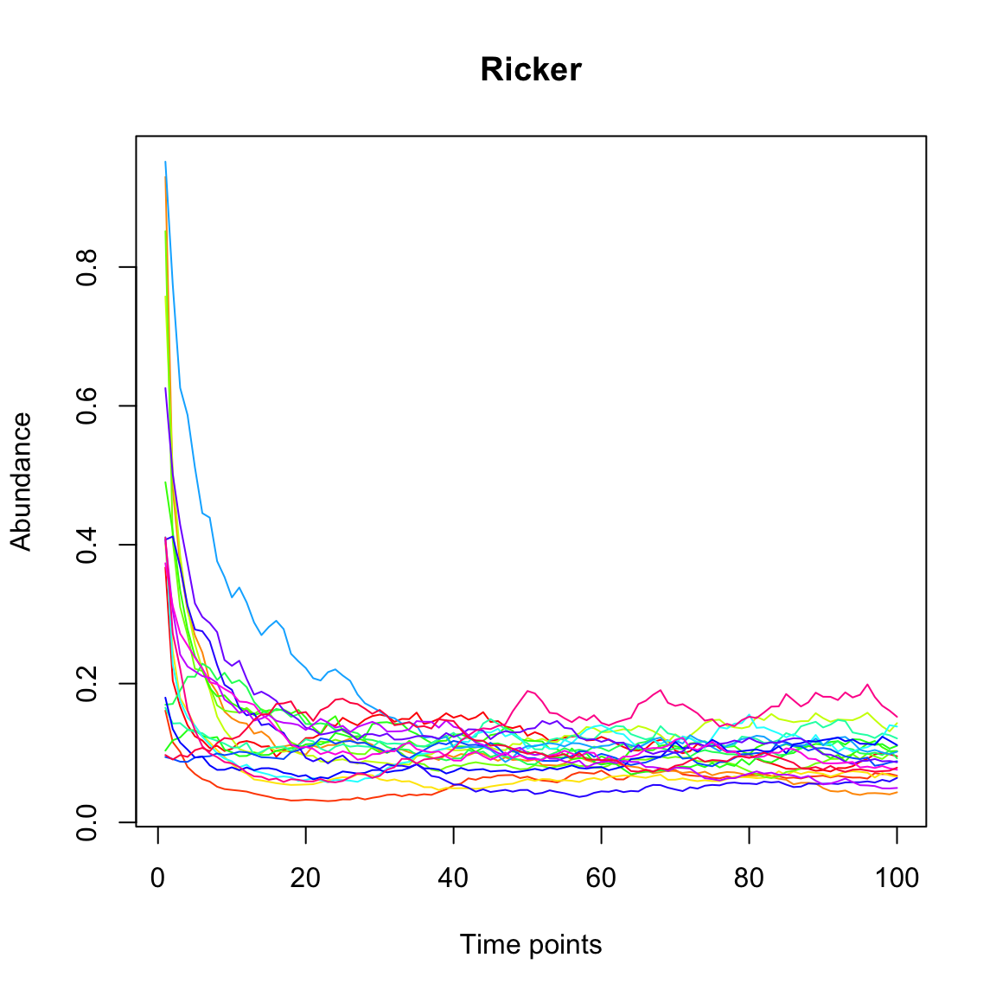
LIMITS
Parameterizes Ricker model (discrete version of gLV)
Fisher& Mehta. (2014). Identifying keystone species in the human gut microbiome from metagenomic timeseries using sparse linear regression. PloS one, 9(7), e102451.

Slide 63
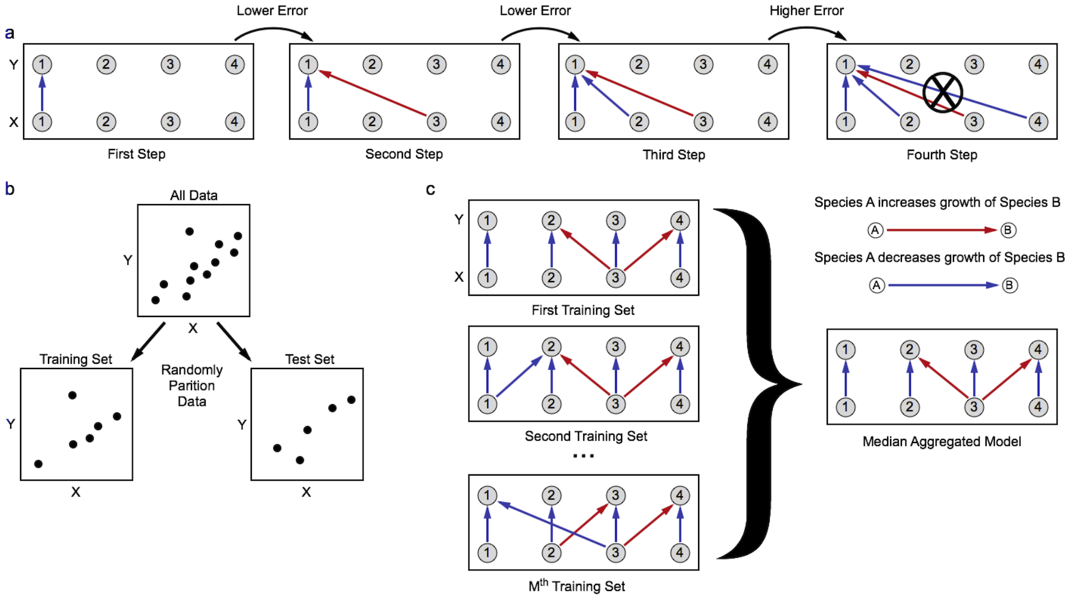
LIMITS
Parameterizes Ricker model (discrete version of gLV)
Forward stepwise regression
Fisher& Mehta. (2014). Identifying keystone species in the human gut microbiome from metagenomic timeseries using sparse linear regression. PloS one, 9(7), e102451.

Slide 64
LIMITS
Parameterizes Ricker model (discrete version of gLV)
Forward stepwise regression
Fisher& Mehta. (2014). Identifying keystone species in the human gut microbiome from metagenomic timeseries using sparse linear regression. PloS one, 9(7), e102451.

Slide 65
LIMITS
Parameterizes Ricker model (discrete version of gLV)
Forward stepwise regression
Fisher& Mehta. (2014). Identifying keystone species in the human gut microbiome from metagenomic timeseries using sparse linear regression. PloS one, 9(7), e102451.

Slide 66
LIMITS
Parameterizes Ricker model (discrete version of gLV)
Forward stepwise regression
Note: other methods available for fitting gLV, Ricker and similar models (e.g. MDSINE)
Fisher& Mehta. (2014). Identifying keystone species in the human gut microbiome from metagenomic timeseries using sparse linear regression. PloS one, 9(7), e102451.

Slide 67
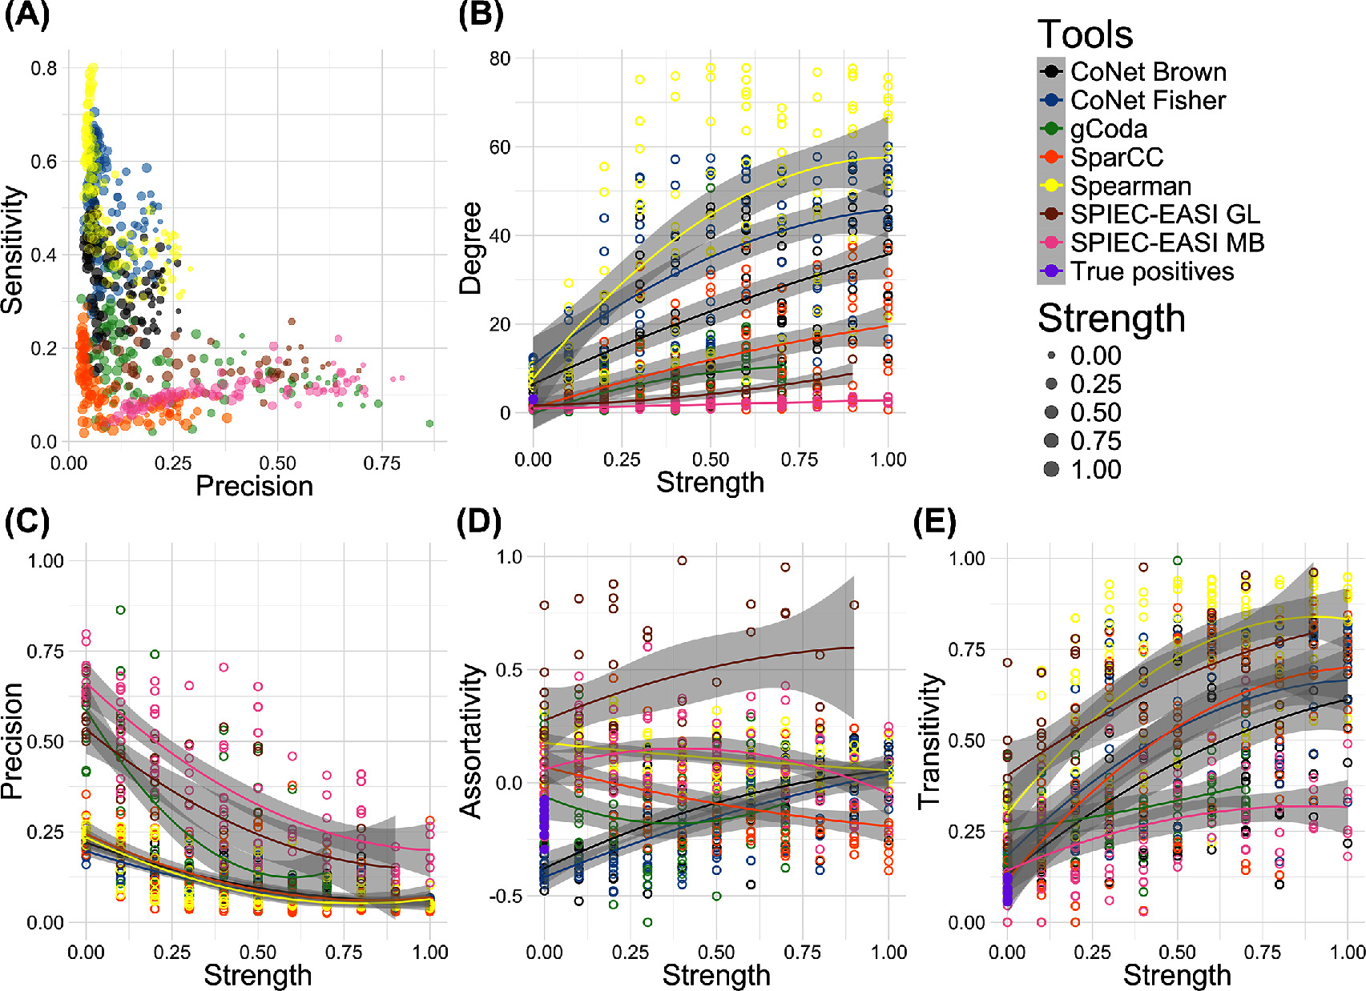
How to pick the best tool?
Is precision important?
Röttjers & Faust. (2018). From hairballs to hypotheses–biological insights from microbial networks. FEMS microbiology reviews, 42(6), 761-780.

Slide 68
How to pick the best tool?
Is precision important?
Röttjers & Faust. (2018). From hairballs to hypotheses–biological insights from microbial networks. FEMS microbiology reviews, 42(6), 761-780.

Slide 69
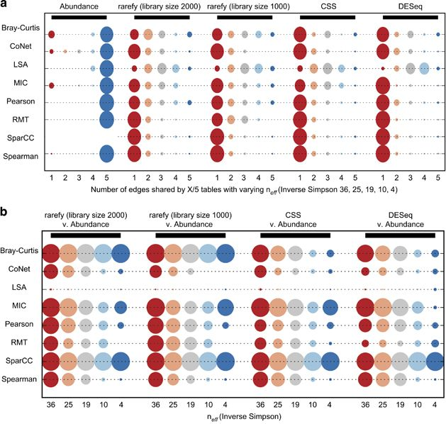
How to pick the best tool?
Is precision important?
Is the data strongly compositional?
Weiss et al (2016). Correlation detection strategies in microbial data sets vary widely in sensitivity and precision. The ISME journal, 10(7), 1669.

Slide 70
How to pick the best tool?
Is precision important?
Is the data strongly compositional?
Weiss et al (2016). Correlation detection strategies in microbial data sets vary widely in sensitivity and precision. The ISME journal, 10(7), 1669.

Slide 71
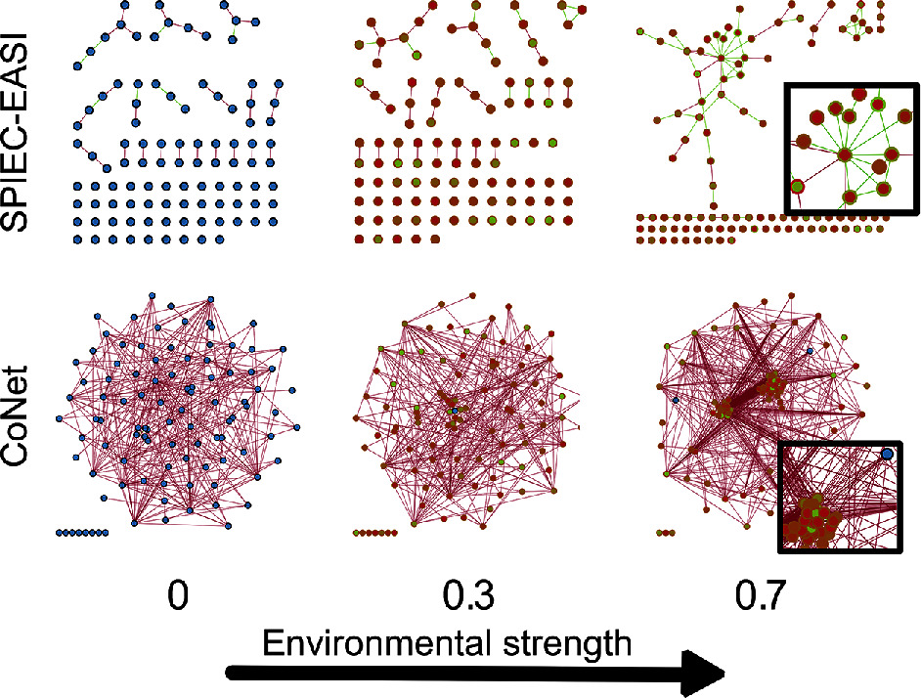
How to pick the best tool?
Is precision important?
Is the data strongly compositional?
Are you looking for clusters?
Röttjers & Faust. (2018). From hairballs to hypotheses–biological insights from microbial networks. FEMS microbiology reviews, 42(6), 761-780.

Slide 72
How to pick the best tool?
Is precision important?
Is the data strongly compositional?
Are you looking for clusters?
Röttjers & Faust. (2018). From hairballs to hypotheses–biological insights from microbial networks. FEMS microbiology reviews, 42(6), 761-780.

Slide 73
How to pick the best tool?
Is precision important?
Is the data strongly compositional?
Are you looking for clusters?
Real-world accuracy is probably low
Röttjers & Faust. (2018). From hairballs to hypotheses–biological insights from microbial networks. FEMS microbiology reviews, 42(6), 761-780.

Slide 74
How to pick the best tool?
Is precision important?
Is the data strongly compositional?
Are you looking for clusters?
Real-world accuracy is probably low
Röttjers & Faust. (2018). From hairballs to hypotheses–biological insights from microbial networks. FEMS microbiology reviews, 42(6), 761-780.

Slide 75
How to pick the best tool?
Is precision important?
Is the data strongly compositional?
Are you looking for clusters?
Real-world accuracy is probably low
Röttjers & Faust. (2018). From hairballs to hypotheses–biological insights from microbial networks. FEMS microbiology reviews, 42(6), 761-780.

Slide 76

Thank you for listening!
Try constructing a network from cross-sectional data:
http://psbweb05.psb.ugent.be/conet/microbialnetworks/conet_new.php http://psbweb05.psb.ugent.be/conet/microbialnetworks/spieceasi.php
Create a network from time series data:
http://hallucigenia-sparsa.github.io/seqtime/articles/network_inference.html

